Slide 1
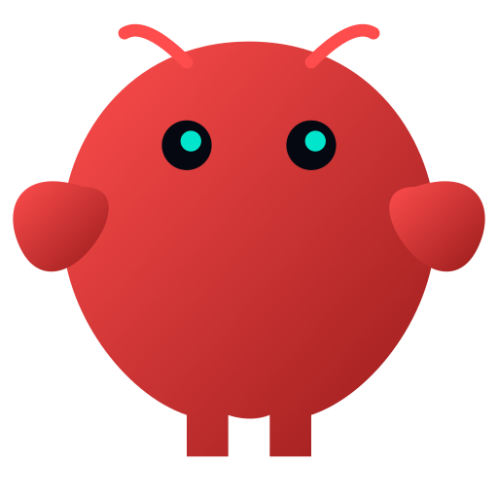
1. AI Reverse Engineering with OpenClaw and MCP
Historical Background of OpenClaw
From Side Project → Global AI Movement
By Paul Chin, PhD

Slide 2
2. Who Created OpenClaw?
Peter Steinberger
Austrian developer & entrepreneur
Creator of PSPDFKit
Started as a weekend experiment

Slide 3
3. Core Philosophy
AI should not just answer — it should do things
Shift from chat-based AI to action-based AI
Executes real-world tasks

Slide 4
4. Timeline Overview
Nov 2025 — Initial release
Jan 2026 — Rebranding
Jan–Feb 2026 — Viral growth
March 2026 — Historic milestone

Slide 5
5. Nov 2025 — Initial Release
Originally called Clawdbot
AI agent executes tasks via messaging apps
Early autonomous agent concept

Slide 6
6. Jan 2026 — Rebranding
Clawdbot → Moltbot → OpenClaw
Trademark + branding reasons
Rapid iteration

Slide 7
7. Jan–Feb 2026 — Viral Growth
100k+ stars in weeks
247k+ stars by March
2M users/week
47k forks

Slide 8
8. March 2026 — Milestone
250k+ GitHub stars
One of fastest-growing open-source projects
Historic growth

Slide 9
9. Global Adoption
Used by developers and startups
Enterprise workflows
Automation pipelines

Slide 10
10. Industry Recognition
Creator joins OpenAI
Project becomes ecosystem
Foundation-based governance

Slide 11
11. Why It Grew Fast
AI that does things
Perfect timing
Open-source
One-person companies

Slide 12
12. AI That Takes Action
Executes tasks, not just chat
Messaging, automation, control

Slide 13
13. Perfect Timing
Built after GPT and Claude maturity
MCP-style integrations ready

Slide 14
14. Open Source Advantage
Anyone can modify and deploy
Rapid community innovation

Slide 15
15. One-Person Company
Automate workflows
Replace multiple roles
Empower individuals

Slide 16
16. Big Picture
Shift from tools → agents
Apps → ecosystems
Beginning of autonomous AI

Slide 17
Thanks for watching

